Slide 1

EDA Project On
Netflix Content Acquisition Strategy
Presented by : RAVINDRA NADH
CHANDU NAYAK
Batch no : 403
INNOMATICS RESEARCH LABS
DISUKHNAGAR BRANCH

Slide 2


Slide 3


Slide 4

Introduction :
About Netflix
World’s leading streaming platform with a vast library of movies and TV shows.
Operates in over 190 countries with diverse audience preferences.
Industry Context
The streaming industry is highly competitive, requiring continuous investment in fresh and engaging content.
Decision-making for content acquisition depends on understanding audience behavior and viewing trends.
Why this analysis matters
Helps Netflix identify what content truly performs in terms of engagement and popularity.
Supports smarter investment — spend less, earn more engagement.
Bridges the gap between data insights and business strategy.

Slide 5

Problem statement:
Netflix acquires and licenses thousands of titles across diverse genres, languages, and formats. However, not all content generates equal audience engagement. With limited acquisition budgets and catalog space, understanding which content categories resonate most with audiences is critical for strategic decision-making.
Analyze Netflix’s US catalog to find which genres, formats (Movies vs Series), and languages attract the most viewers.
Identify what drives higher engagement, ratings, and popularity.
Use insights to guide future content investment and improve the catalog strategy.
Objective:

Slide 6
Metrics Table :
Year | Investment (Content Spend, $B) | Net Profit ($B) | Profit ÷ Investment
2018 | 12.0 | 1.2 | 10%
2019 | 14.6 | 1.9 | 13%
2020 | 17.3 | 2.8 | 16%
2021 | 17.0 | 5.1 | 30%
2022 | 17.0 | 4.5 | 26%
2023 | 13.0 | 5.4 | 42%
2024 | 16.2 | 8.7 | 54%
Observation:
From 2018–2021, Netflix’s profit was only about 10–25% of its investment.
Recently (2023–2024), profit margins have improved — Netflix is finally reaping returns from earlier investments.
Still, the cost base is huge, meaning most of the money goes into content before profits emerge.

Slide 7

Domain Knowledge:
1. Streaming Platform Overview
Subscription-based, on-demand video service.
Offers diverse movies & TV shows across global markets.
2. Content Acquisition Process
Buys content (licensed titles) and creates its own (Netflix Originals).
Tries to pick content that balances cost, popularity, and what people want to watch.
3. Catalog Diversity
Wide mix of genres, languages, and formats.
Designed to attract different audience segments.
4. Performance Metrics
Key indicators: Watch Time, Completion Rate, Ratings, Popularity.
Uses these numbers to see what’s working and what’s not.
5. Strategic Importance
Analyzes this data to decide what to buy or make next.
Helps maximize ROI, retention, and catalog efficiency.

Slide 8

Executive Summary :
Project Overview: Analyzed 3,990 Netflix titles to identify optimal content acquisition strategies
Key Finding: Only 5.7% of content becomes hits (227/3,990 titles)
Primary Goal: Improve ROI on $18B annual content investment
TV Shows Outperform: TV series found to be more successful than movies in most genres.
Quality Standards: Many titles are average or poor; raising quality requirements saves money and boosts viewer experience.
Smarter Choices: Recommend targeting top-performing genres and languages to drive more hits and engagement.
Solution Impact: Projected hit rate improvement from 5.7% to 15% (2.6x increase)

Slide 9

Data Collection - Web Scraping
API Used: TMDB API (The Movie Database)
Url : https://www.themoviedb.org/
Api key : [0c55***********************0af9d6]
Data Scraped:
2,000 Movies (100 pages × 20 movies)
2,000 TV Shows (100 pages × 20 shows)
Total 4000 rows × 16 columns
Key Fields Collected: Title, content type, release date, votes, popularity, original_language
tmdb_id, original_title, genre_ids, vote_average, vote_count, overview, adult, video, Poster_path, backdrop_path, scraped_date.
Region: US-based Netflix catalog
Tool: Python (requests, pandas)

Slide 10
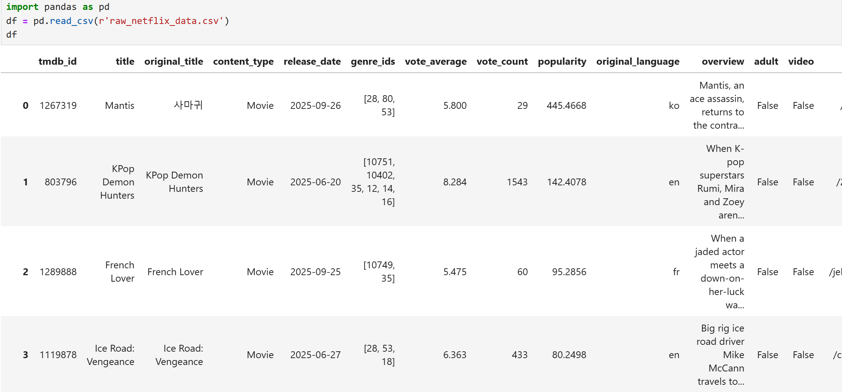
Raw Data Set:

Slide 11

Data Quality Issues Identified :
Overview: 0.23% missing
Poster/backdrop paths: <1% missing
Duplicates: 12 duplicate entries found
Data Type Issues: Dates stored as strings, genres as encoded IDs
Language Codes: 44 different language codes needed standardization
New columns needs to be derived from existing data

Slide 12

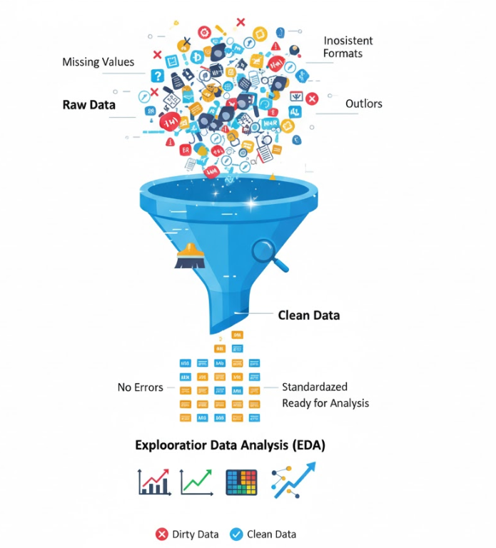
Data Cleaning :
Columns Dropped:
Removed: original_title, overview, adult, video, poster_path, backdrop_path, scraped_date
Reason: Not relevant for content performance analysis
Duplicate Removal: 10 duplicate records removed
Final Dataset: 3,990 unique titles with 9 core columns
Language Standardization:
Converted 44 language codes to full names (e.g., 'en' → 'English')
Created language_grouped: Top 6 languages + 'Other' category
Date Processing:
Converted release_date from string to datetime format
Extracted release_year for temporal analysis
Genre Transformation:
Mapped 27 genre IDs to readable names (28 → "Action", 18 → "Drama")
Extracted primary_genre from multi-genre titles
Column Renaming for Clarity:
tmdb_id → id
vote_average → rating
vote_count → num_votes
original_language → language
content_type → type
popularity→ popularity_score

Slide 13
Feature Engineering - New Metrics Created
rating_category: Poor (<5) | Average (5-6.5) | Good (6.5-8) | Excellent (8-10)
popularity_category: Low | Medium | High | Very High (quartile-based)
engagement_score: rating × log(num_votes + 1) — measures true audience impact
vote_reliability: Low (<100) | Medium (100-1000) | High (1000-5000) | Very High (>5000)
primary_genre: First genre from multi-genre titles
language_grouped: English, Korean, Spanish, French, Hindi, Japanese, Other
recent_release: Boolean flag for content released in last 3 years (2022-2025)
is_hit: Binary classification
Criteria: rating ≥ 7.5 AND num_votes > 1000
Represents commercially successful content
Result: 5.7% of titles are hits (227/3,990)

Slide 14
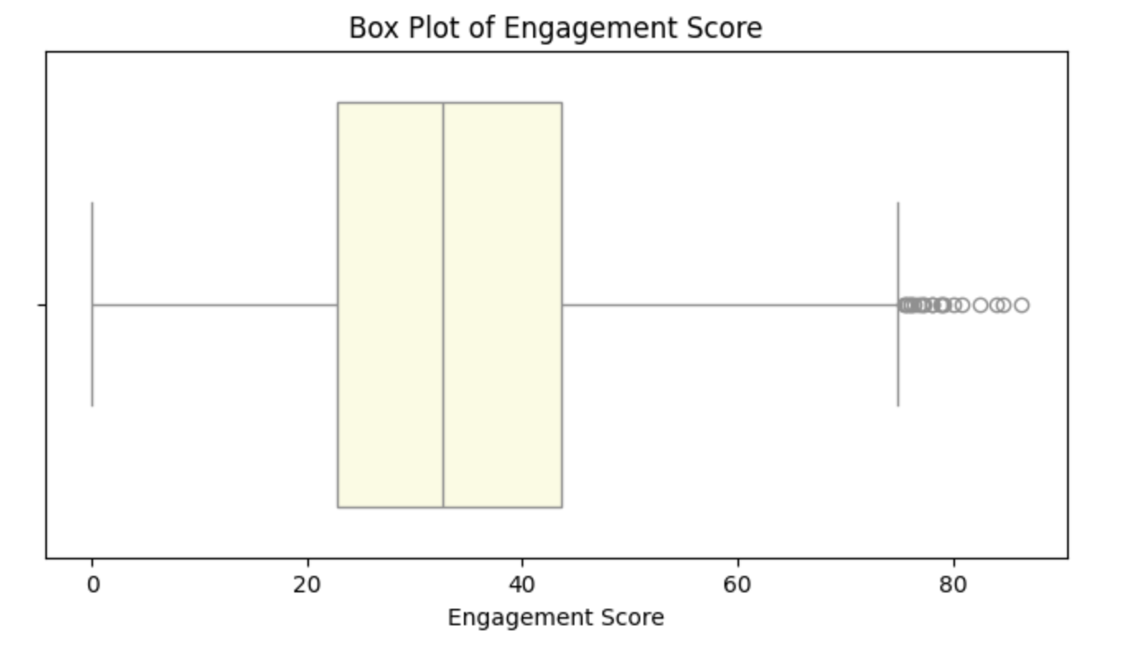
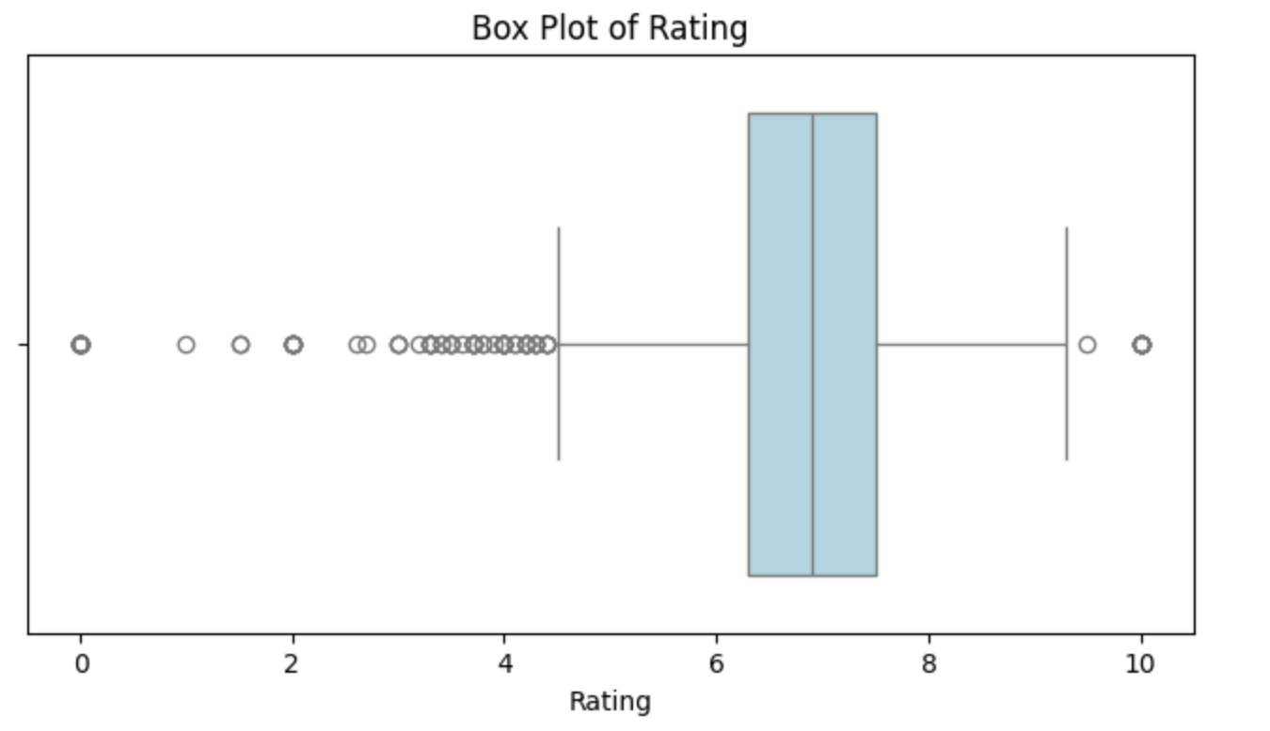
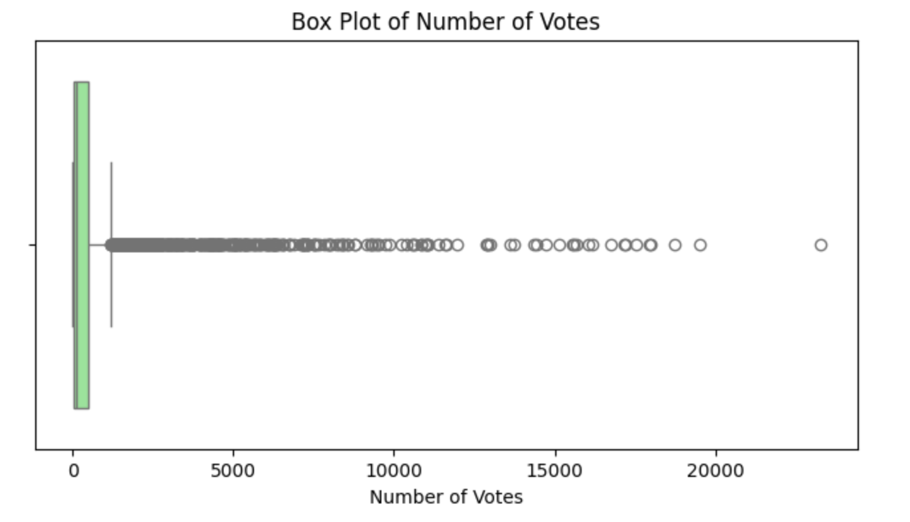
Outlier Analysis :
Approach: Used IQR method and boxplots for numerical variables
Findings:
High ratings (9-10): Legitimate top-rated content with low votes
Low ratings (<3): Real poor-quality content or insufficient data
High vote counts: Popular mainstream content (up to 23,257 votes)
High popularity scores: Trending/viral content
Decision: Retained all outliers as they represent real audience behavior

Slide 15

Final Clean Dataset :
Shape: 3,990 rows × 15 columns
No Missing Values: 100% data completeness
No Duplicates: All unique entries
Optimized Data Types:
Categorical: type, language, primary_genre, rating_category, language_grouped.
Numerical: rating, num_votes, popularity_score, engagement_score,release_year.
Boolean: recent_release, is_hit.
Memory Usage: 401.9 KB (efficient storage)

Slide 16
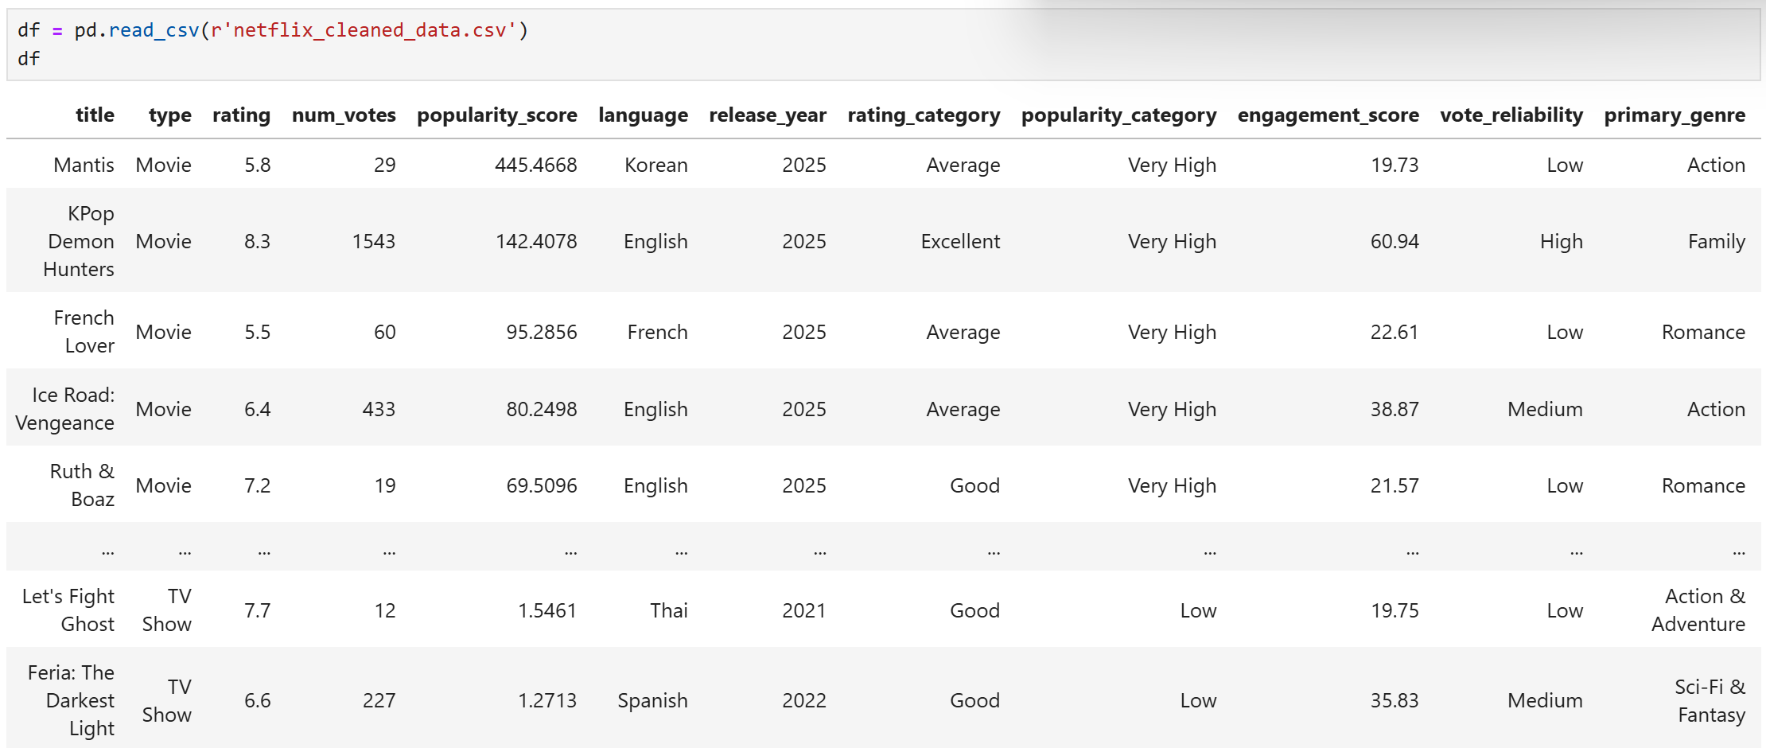
Final Clean Dataset:

Slide 17

UNIVARIATE ANALYSIS
Single-variable analysis to understand distributions
Purpose: Understand current content portfolio composition
Analyses Performed:
Hit vs Non-Hit distribution
Content realse over years (trends)
Genre frequency
Language distribution
Rating patterns
Vote distribution
Engagement metrics

Slide 18
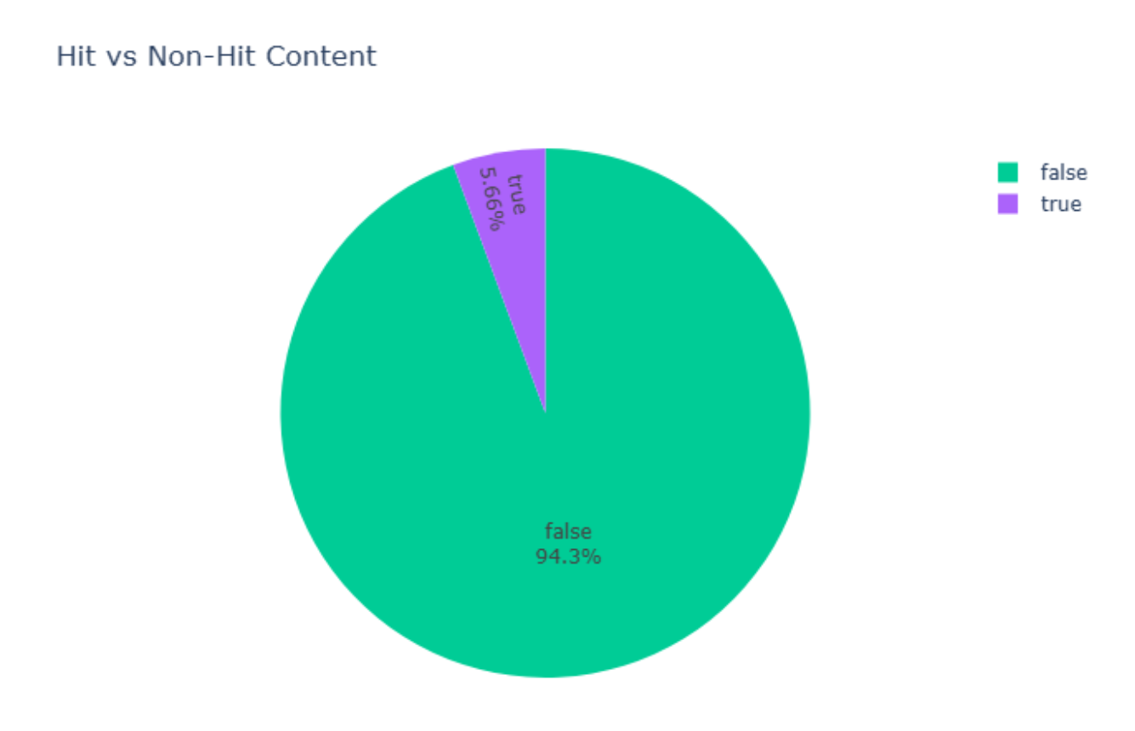
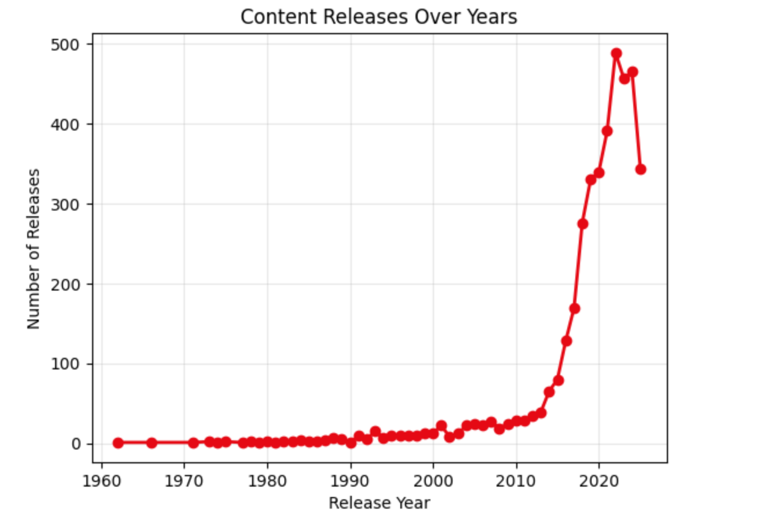
Hit vs. Non-Hit Content
Only 5.7% of titles are hits → 93% fail to create impact.
Indicates inefficient content spending.
Need to prioritize formats/genres with higher hit probability
Content Releases Over the Years
Release volume increased after 2015, but hit rate did not improve.
Quantity ↑ ≠ Quality ↑.
Shift from “more titles” to “better titles”.

Slide 19
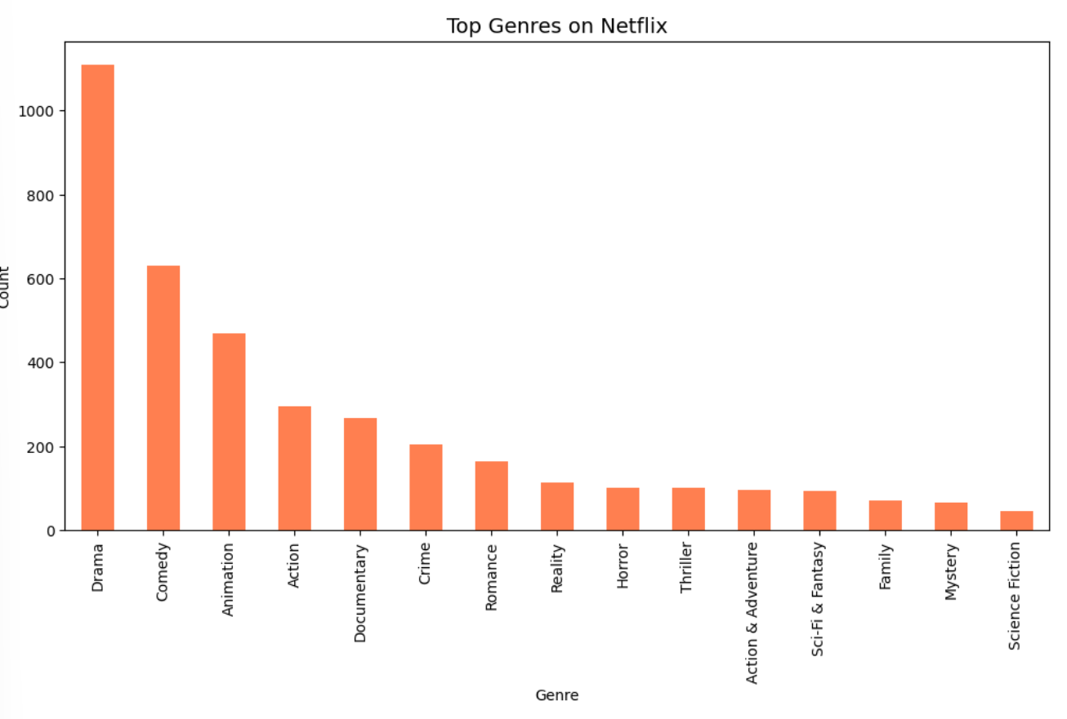
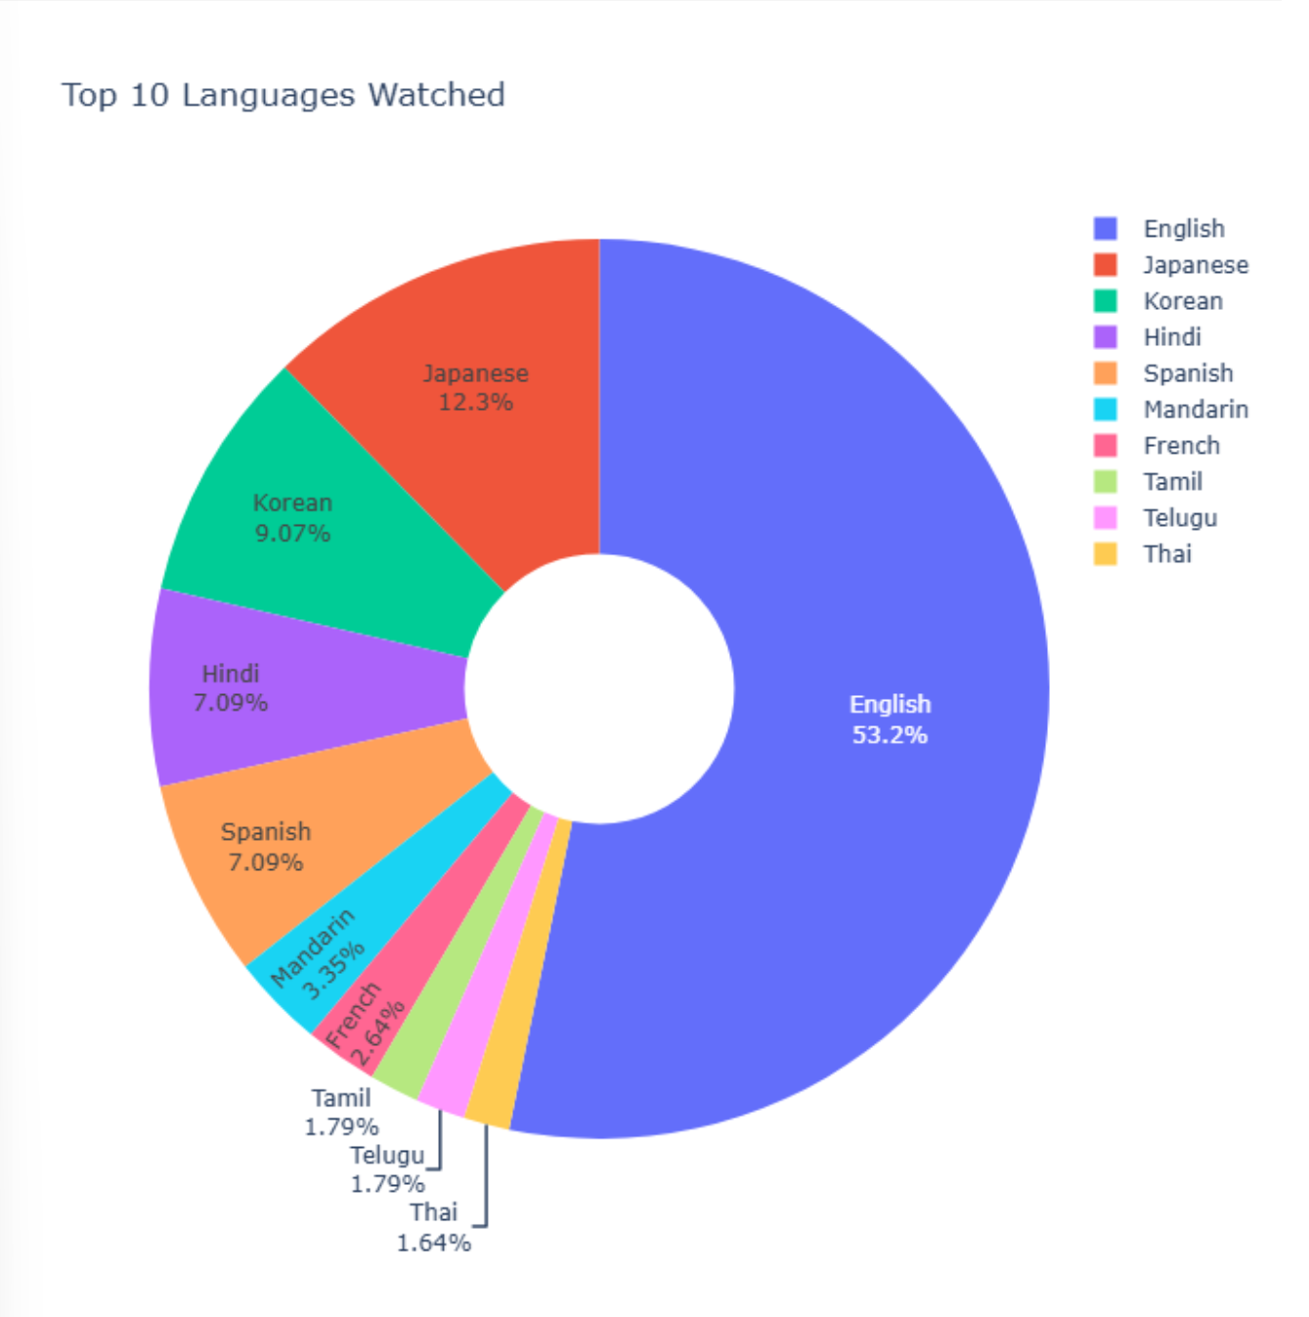
Top Genres on Netflix
Drama,Comedy dominates catalog but has low hit rate.
Some smaller genres outperform in engagement.
Rebalance genre portfolio toward high-hit genres.
Top 10 Languages Watched
English dominates, but global audience demand is rising.
Japanese, Korean, and Hindi titles show strong engagement growth.
Current catalog underutilizes language diversity.
Opportunity: Expand regional-language high-performing segments to boost global reach and hit rate.

Slide 20
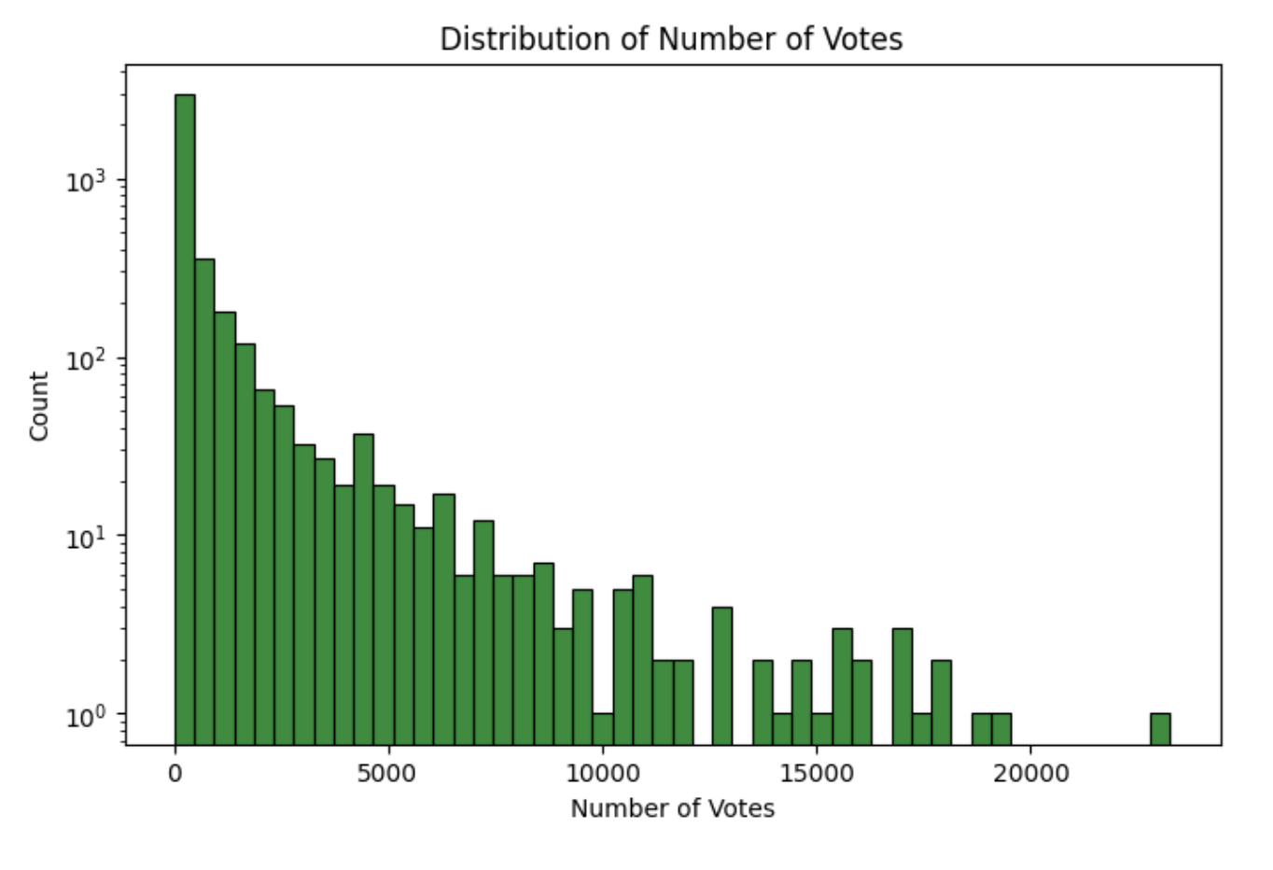
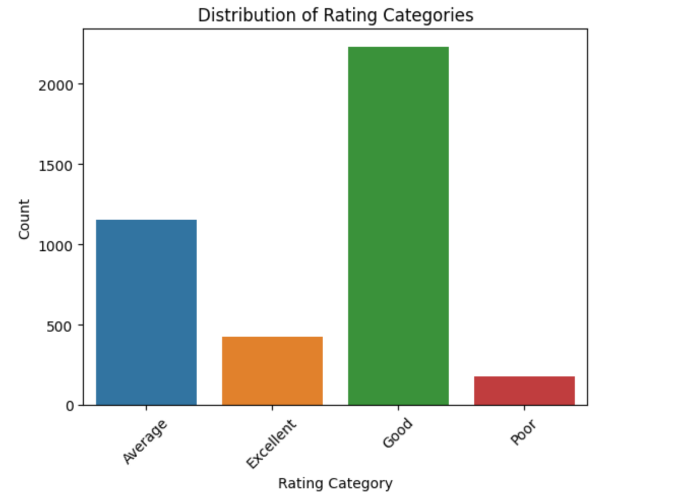
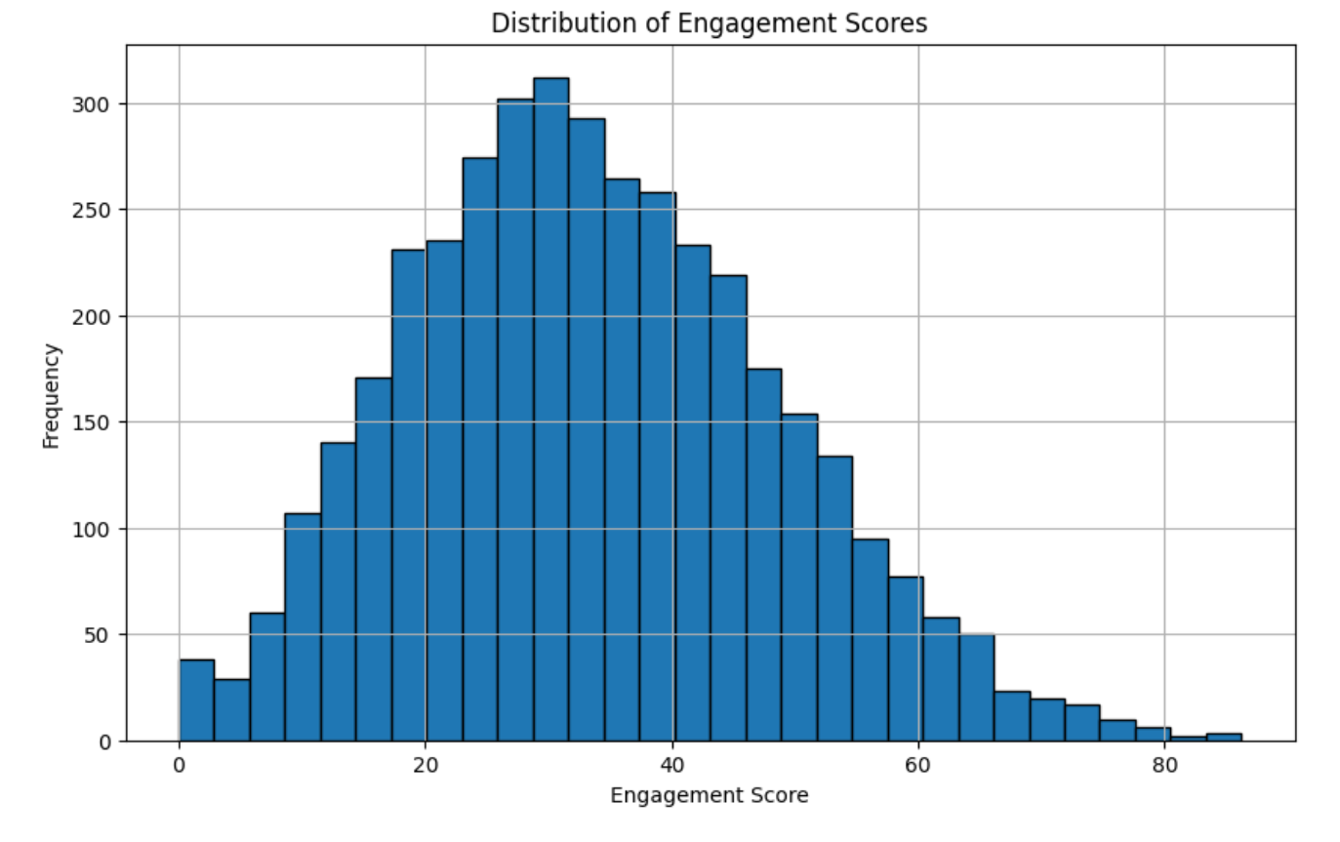
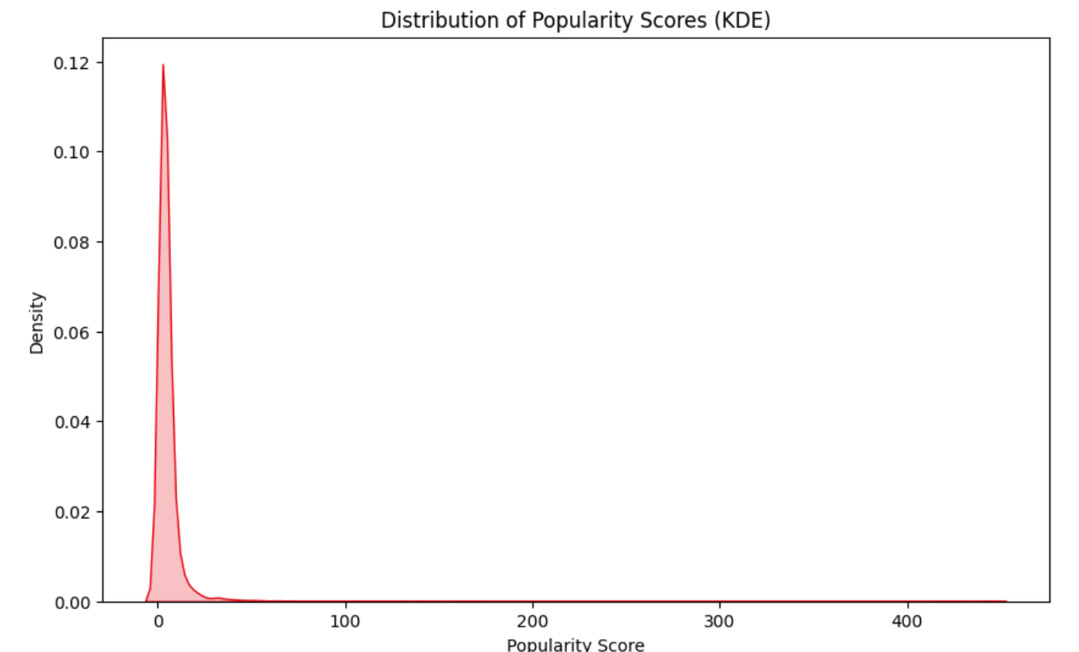
Some more Uni-variate analysis :

Slide 21

BIVARIATE ANALYSIS
Two-variable relationship analysis
Purpose: Identify which factors drive content success
Key Comparisons:
Movies vs TV Shows performance
Genre vs Rating
Genre vs Engagement
Type vs Hit Rate
Hit rate by Top 10 languages
Rating vs Votes correlation
Hit rate by Top 10 Genre
Rating by content type and language
Avg stats Hit vs Non -Hits

Slide 22
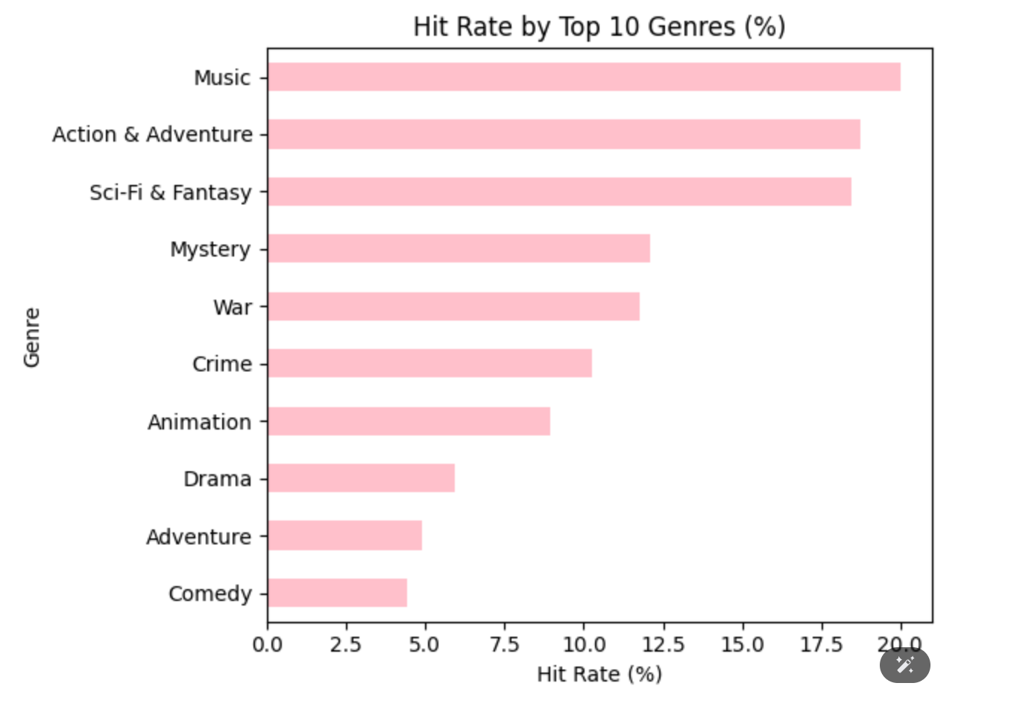
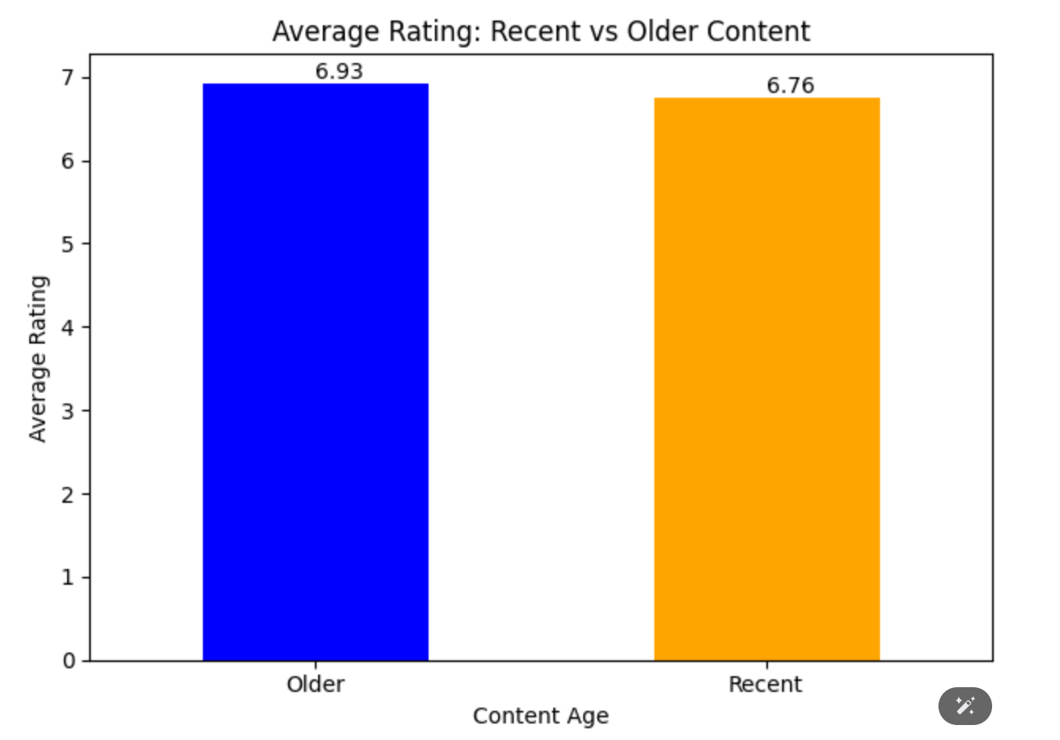
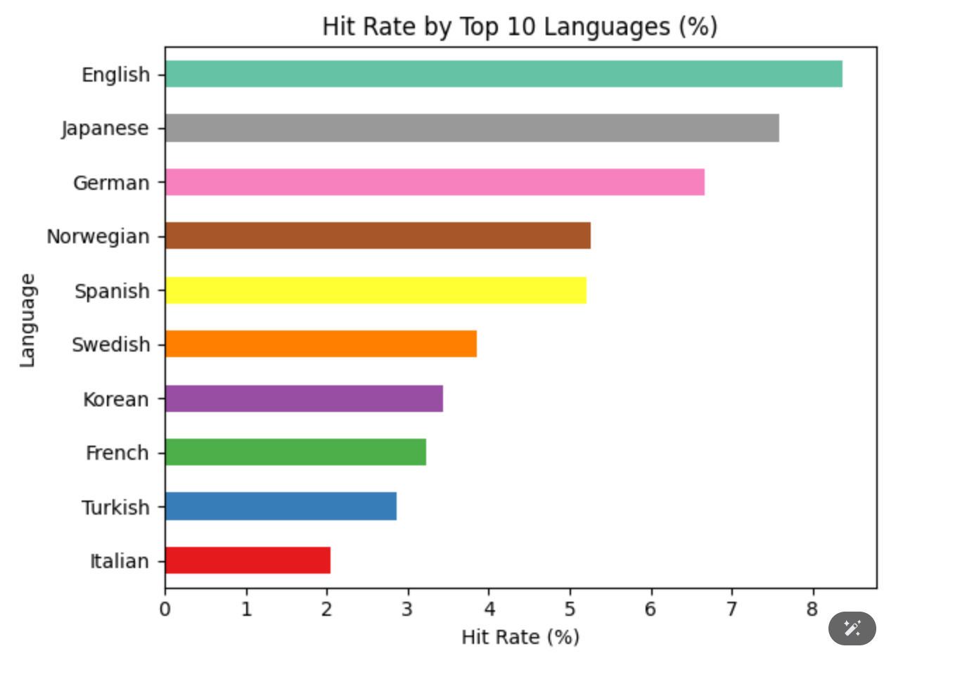
Hit Rate by Top 10 Genres (%)
Music, Action & Adventure, Sci-Fi have 15-20% hit rates.
Drama and Comedy have only 4-6% hit rates despite high volume.
Genre choice directly impacts success probability.
Solution: Shift from Drama to high-hit genres.
Average Rating:
Recent vs Older Content
Older content rates slightly higher
(6.93 vs 6.76).
Recency alone doesn't guarantee quality.
Legacy titles still hold audience value.
Solution: Balance new releases with
curated classics.
Hit Rate by Top 10 Languages (%)
English and Japanese lead with 7-8% hit rates.
German, Norwegian, Spanish show strong performance.
Language-market optimization is underutilized.
Solution: Target high-performing language segments.

Slide 23
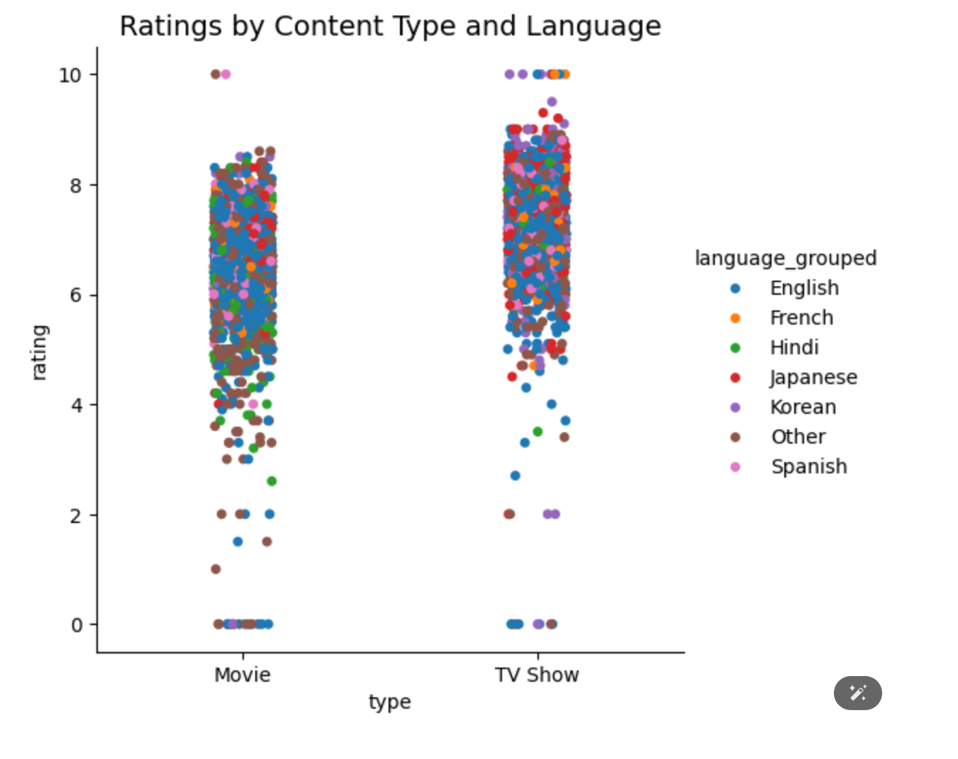
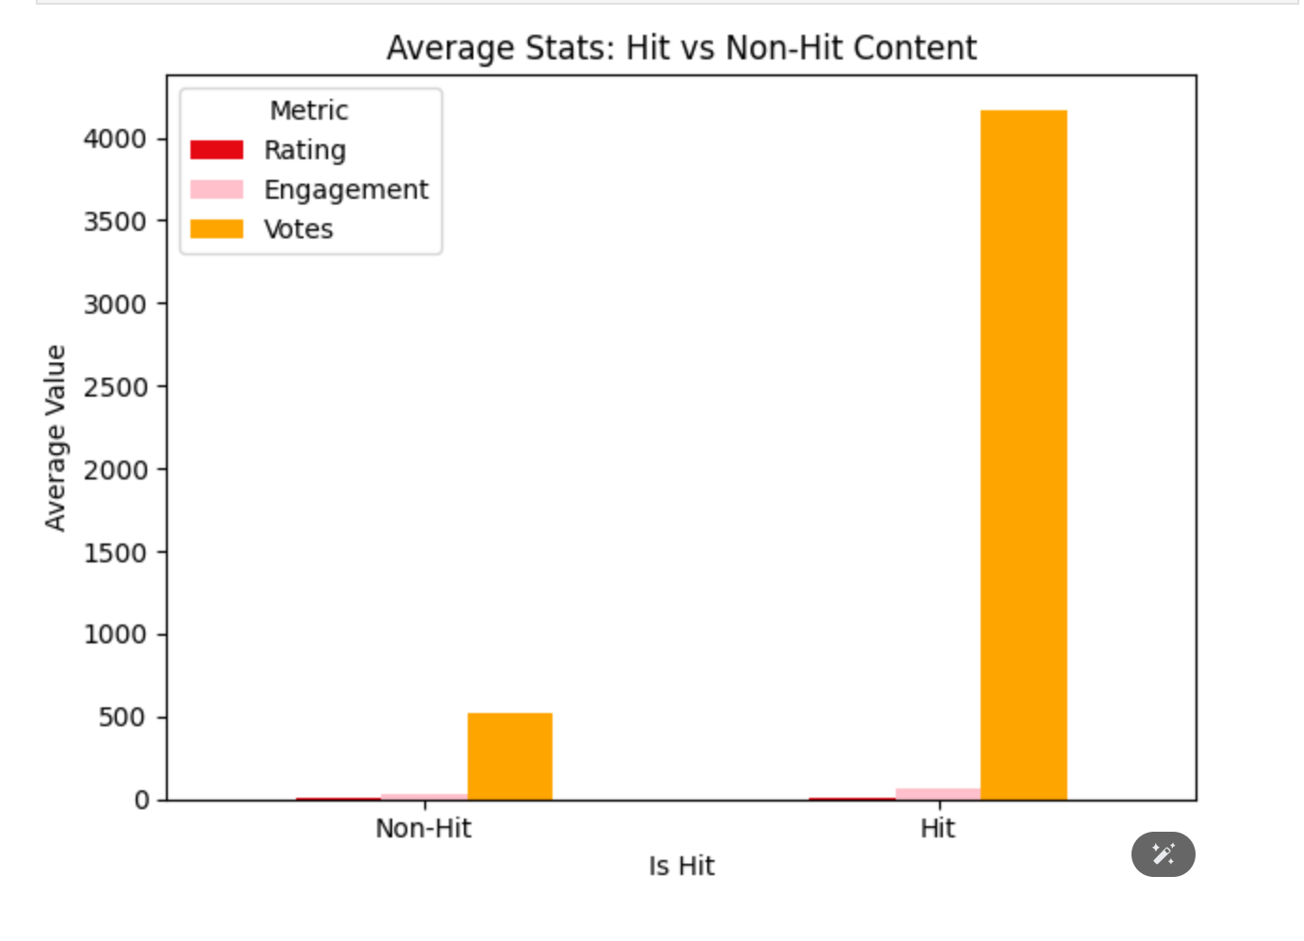
Ratings by Content Type and Language
TV Shows consistently outperform Movies across languages.
Japanese and Korean content rate highest overall.
Type-language combinations reveal hidden strengths to improve.
Solution: Prioritize TV format in top language markets.
Average Stats: Hit vs Non-Hit Content
Hits = 8× engagement.
Hits = 10× more votes.
Ratings alone ≠ success.
Success needs multiple metrics.
Action: Select titles with rating + engagement threshold.

Slide 24
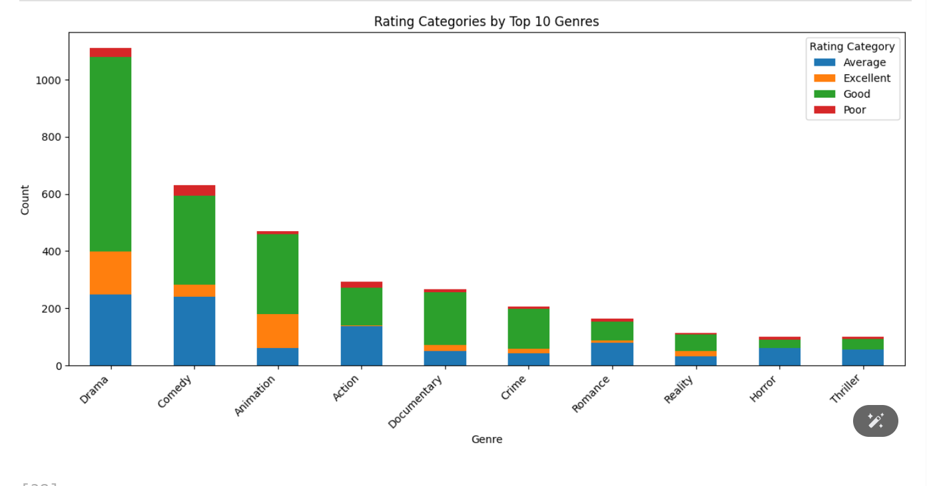
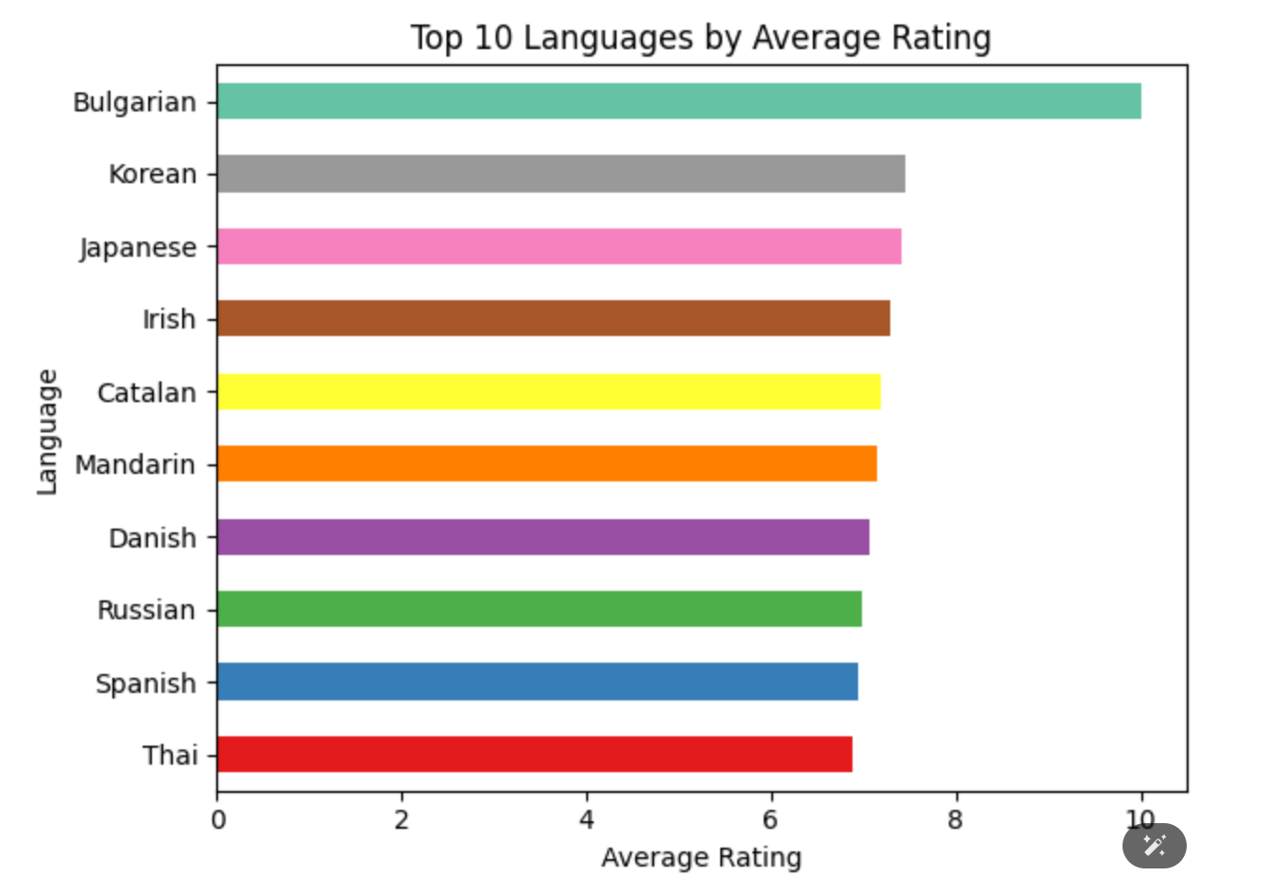
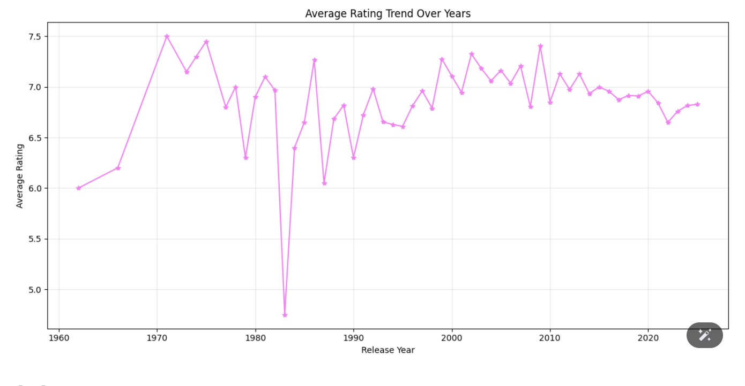
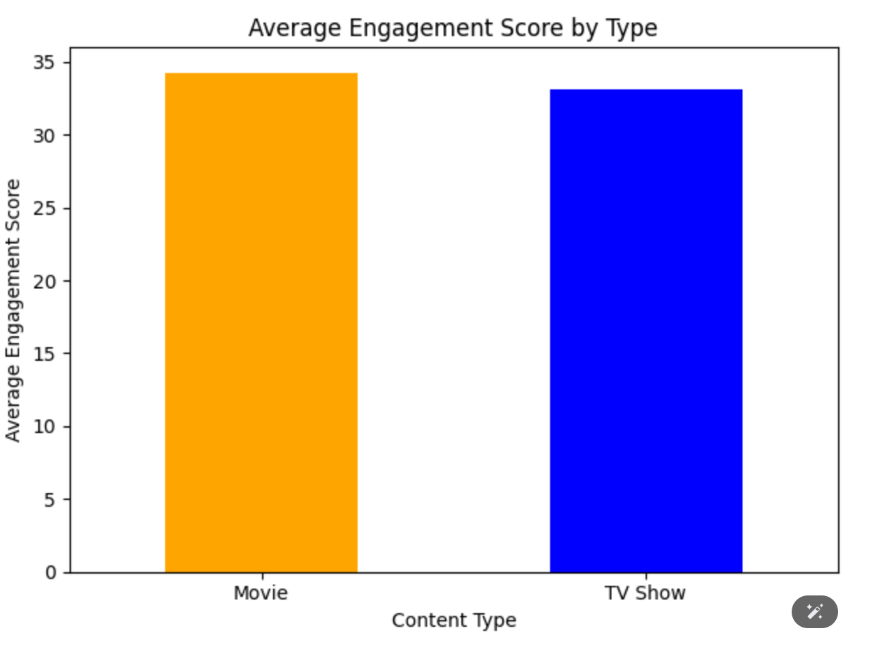

Slide 25
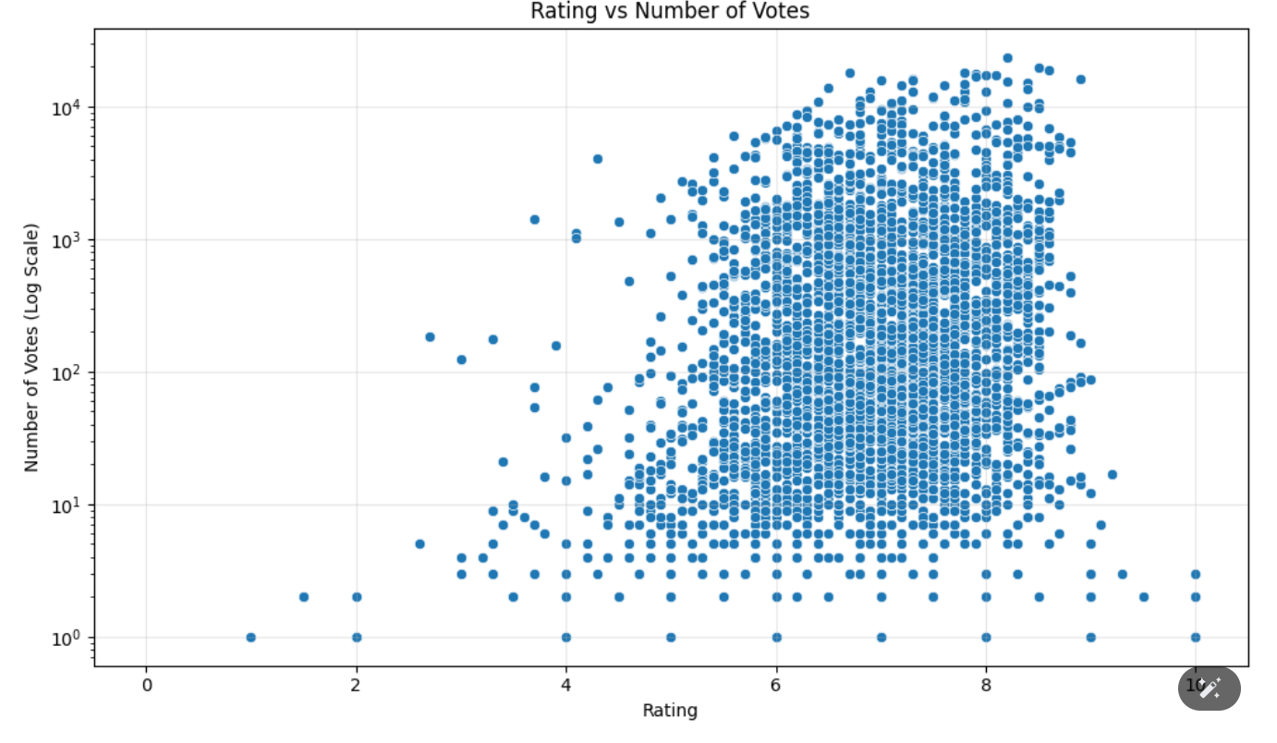
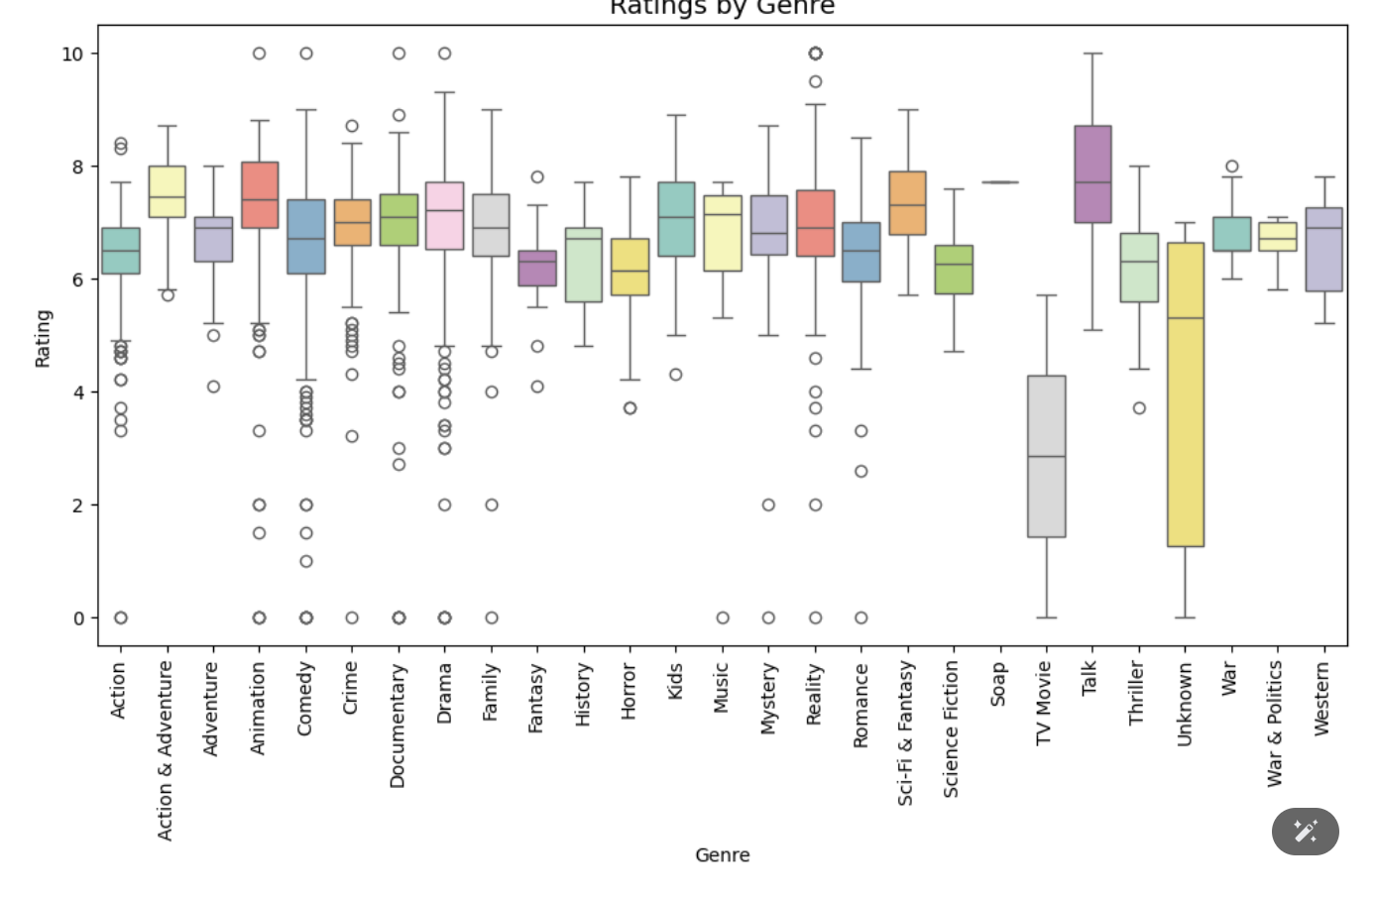
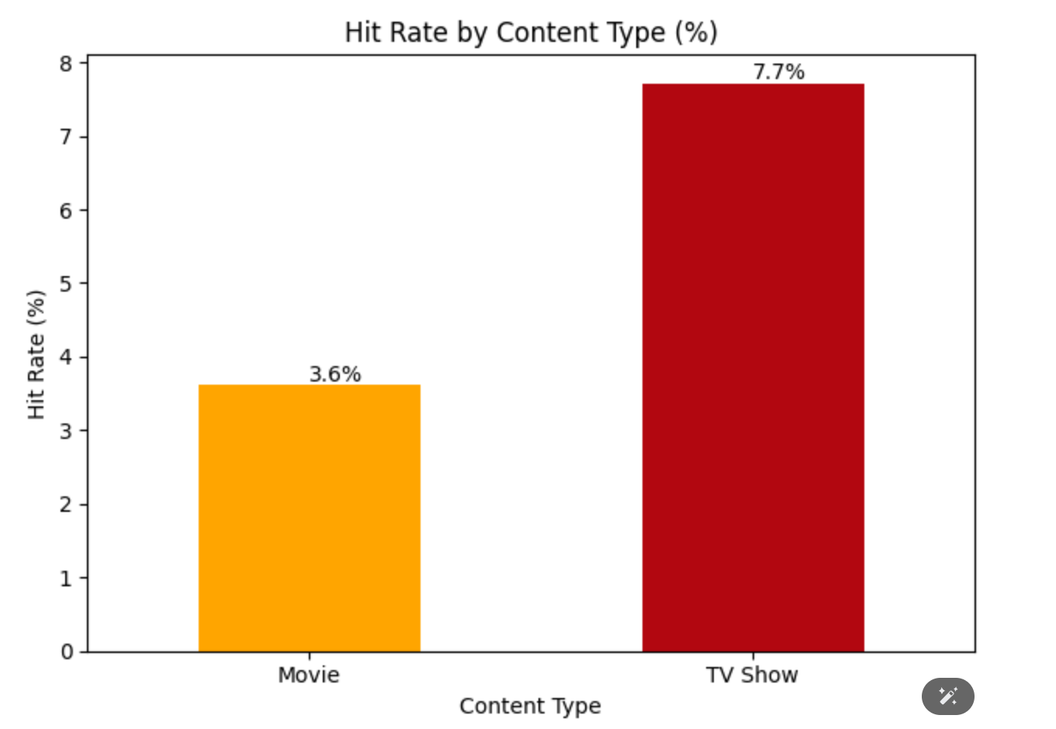
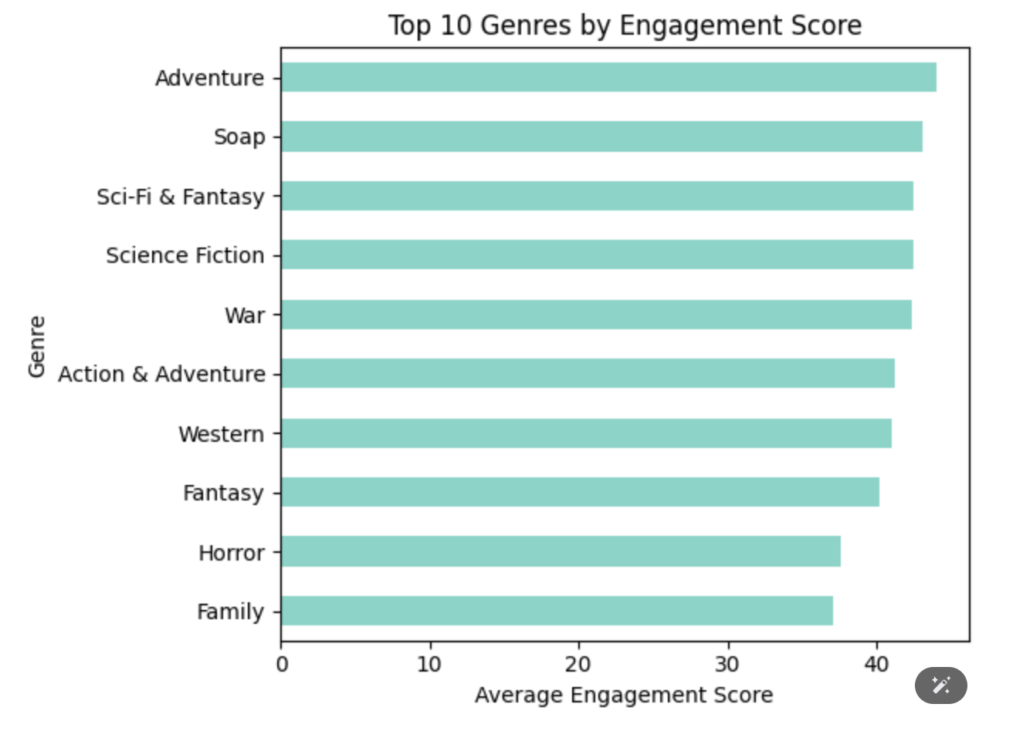

Slide 26

MULTIVARIATE ANALYSIS
Analyzing multiple variables simultaneously
Purpose: Identify optimal content combinations
Analyses:
Format + Genre + Language combinations
Success predictors (multiple factors)
Temporal trends (year + genre + type)
Language-genre-quality triangulation

Slide 27
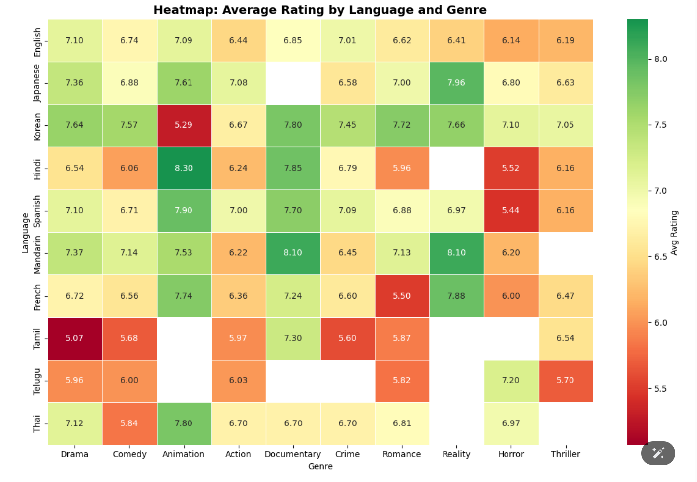
Heatmap: Average Rating by Language and Genre
High-performers: Hindi Animation, Mandarin Documentary, Japanese Reality → Strong ratings.
Japanese, Korean, Mandarin content shows consistent audience loyalty.
Low-performers: Tamil Drama, Reality, French Romance → Reduce focus.
Animation & Documentary work well globally → Scalable opportunities.
Drama & Comedy vary by language → Success depends on local context.
Action: Invest in strong language–genre pairs; reduce weak clusters.
Enables Netflix to target top-performing markets and genres, boosting hit probability.
Drives efficient spending and higher audience retention.

Slide 28
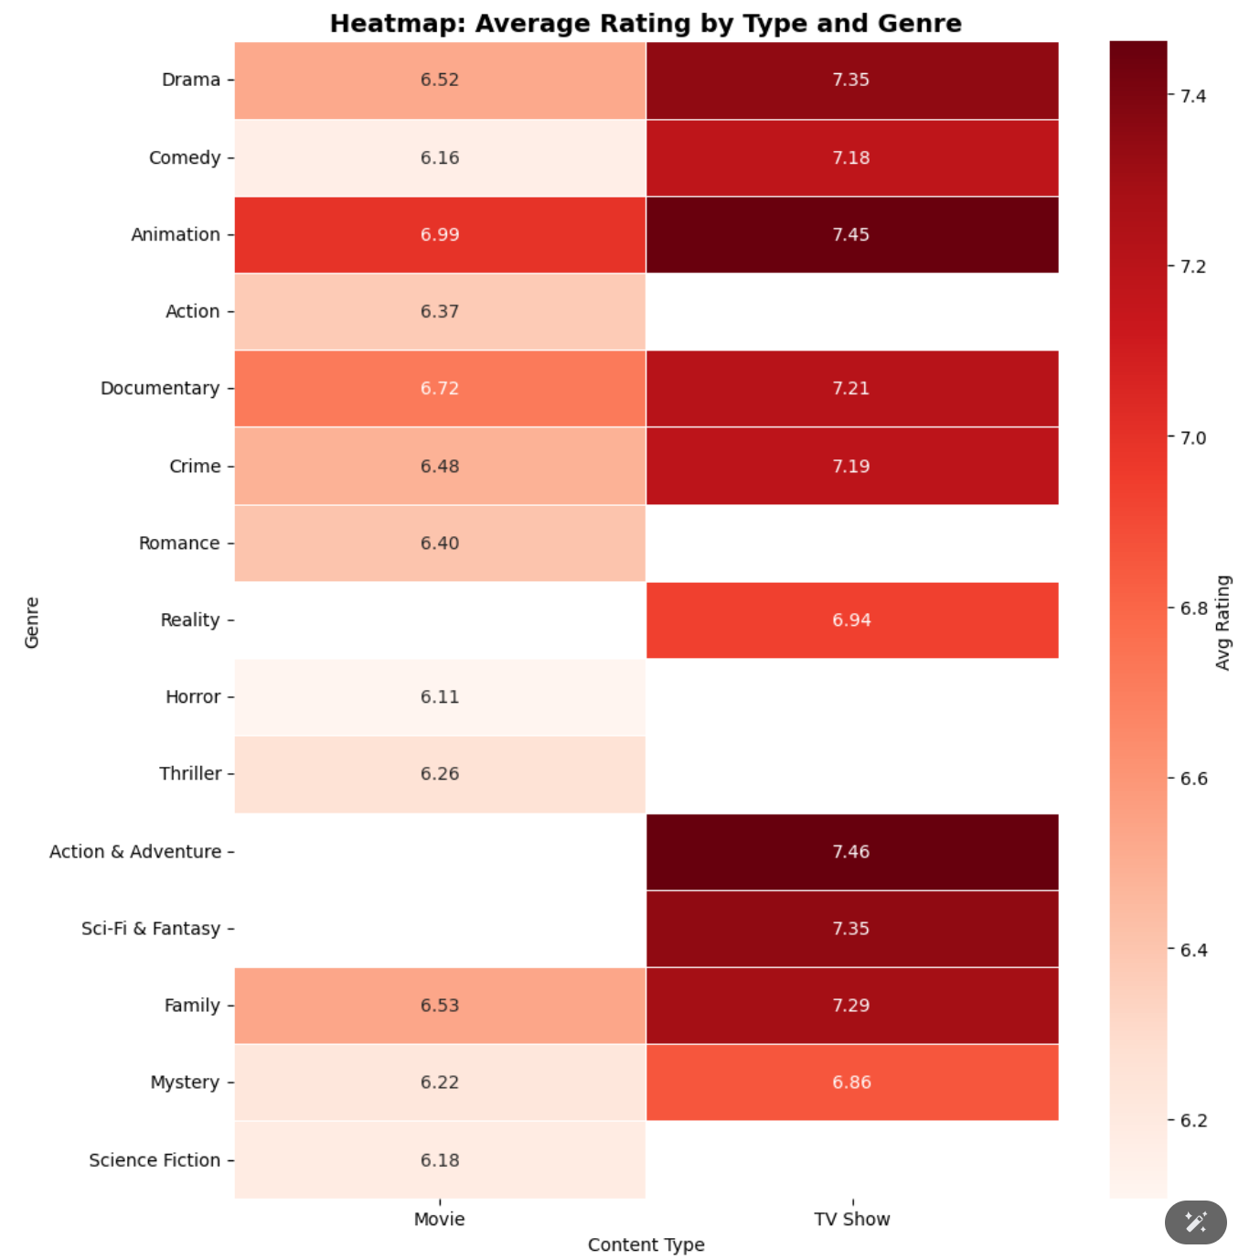
Heatmap: Average Rating by Type & Genre
TV > Movies across most genres.
Drama TV (7.35) > Drama Movies (6.52) → clear format advantage.
Top performers: Animation, Documentary, Action& adv
TV (~7.45+).
Movies in Horror & Sci-Fi underperform.
TV formats deliver stable quality & better retention.
Overall: Audiences prefer episodic, long-form content.
Action: Shift investment toward high-performing TV genres; reduce weak Movie formats.

Slide 29
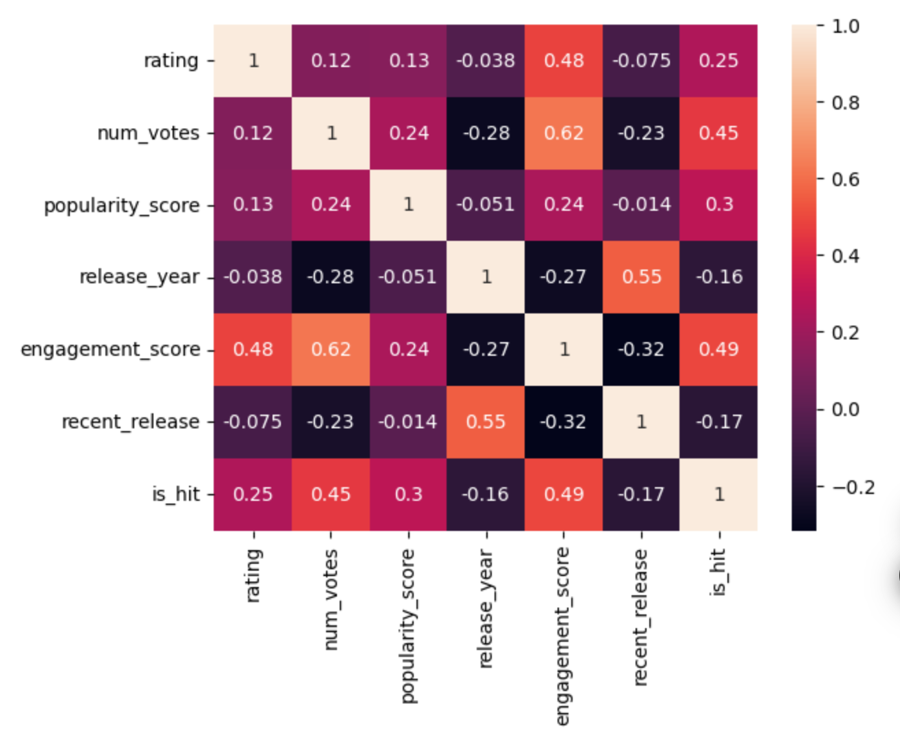
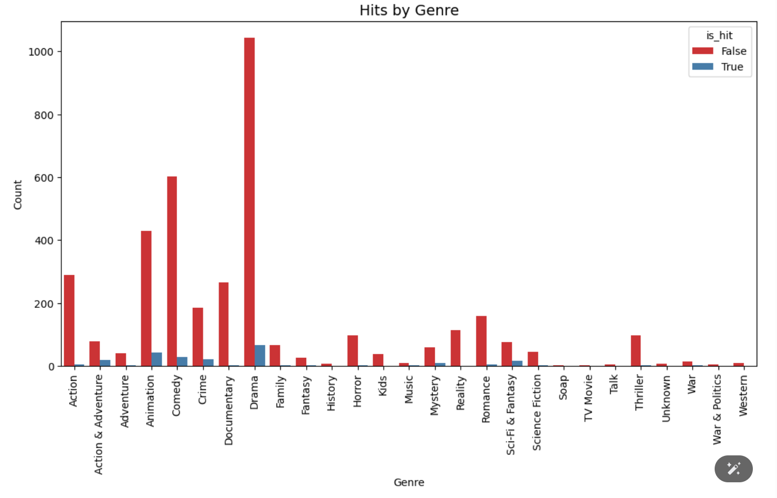
Correlation Heatmap:
Engagement (0.49) and Votes (0.45) are strongest hit predictors.
Rating alone is weak (0.25) → success is multi-metric.
Engagement ↔ Votes are linked (0.62) → audience interaction matters.
Recency shows weak impact → new content ≠ guaranteed success.
Action: Use combined thresholds (Rating + Engagement + Votes) for content selection.
Hits by Genre
Drama = high volume, low hit rate → oversaturated.
Animation, Music, Mystery show strong hit ratios.
Most genres produce more flops than hits → focus matters.
Action: Reduce Drama spend; invest more in high-hit genres.

Slide 30
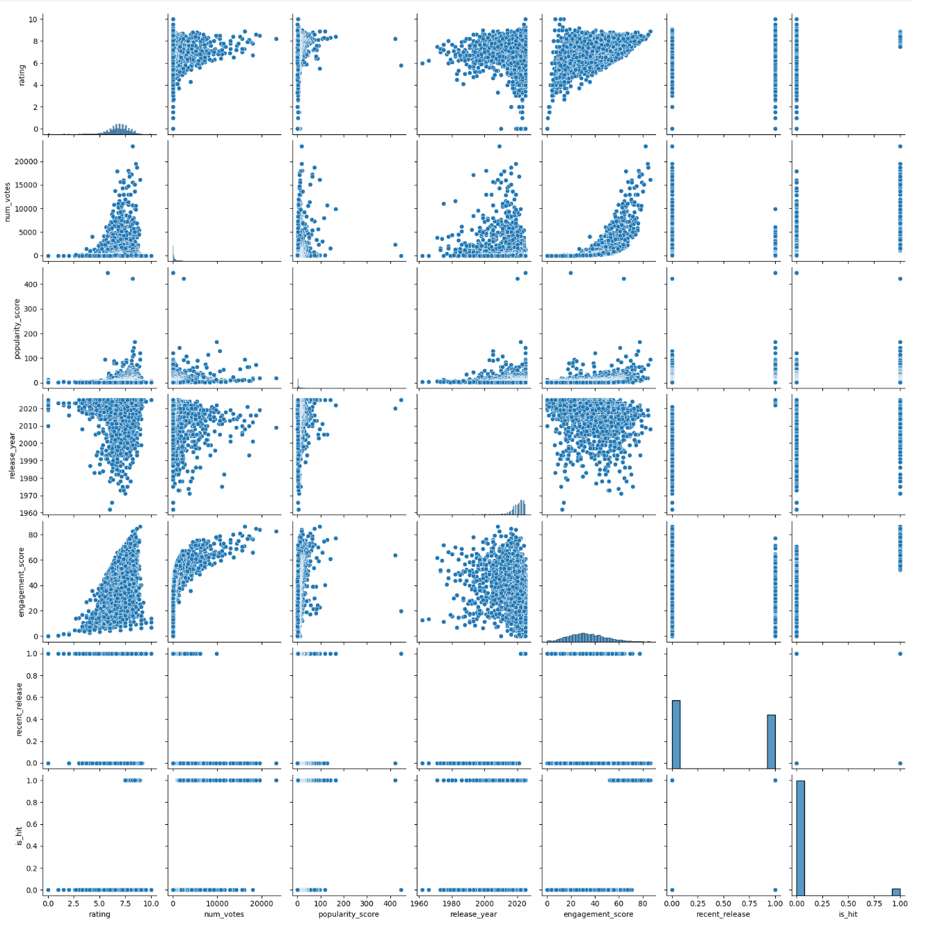
Pair Plot (Scatter Matrix)
Hits = high engagement + votes + ratings together.
One strong metric alone isn’t enough.
Hits are rare; most content underperforms.
Popularity rises with both engagement & votes.
Release year not a success factor.
Few titles meet all success conditions.
Strategy: Pick new content scoring high on all
three metrics.

Slide 31
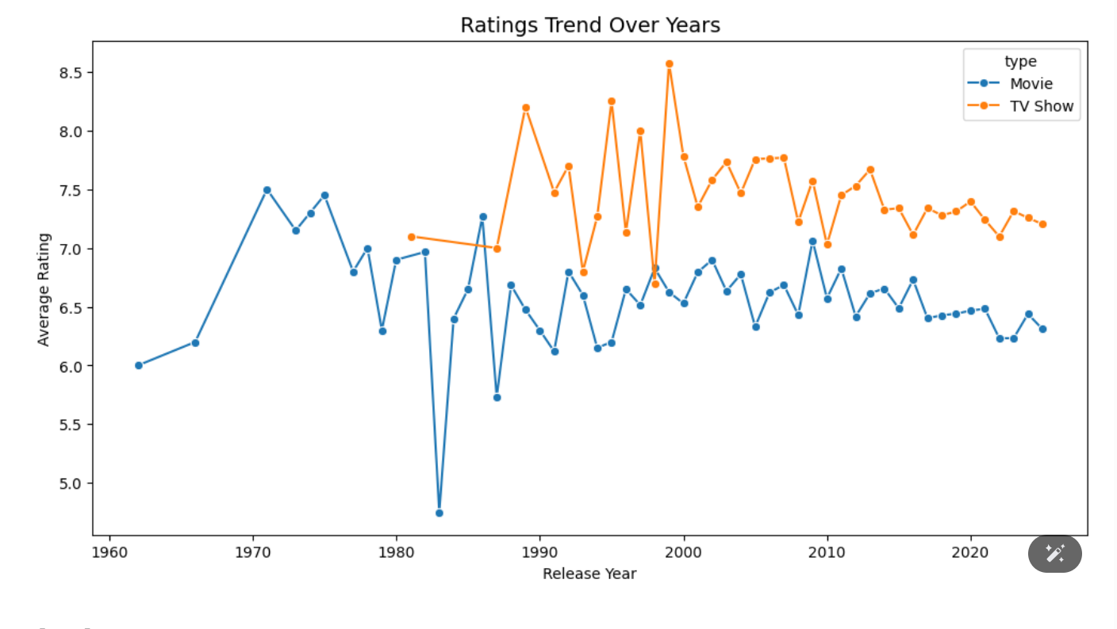
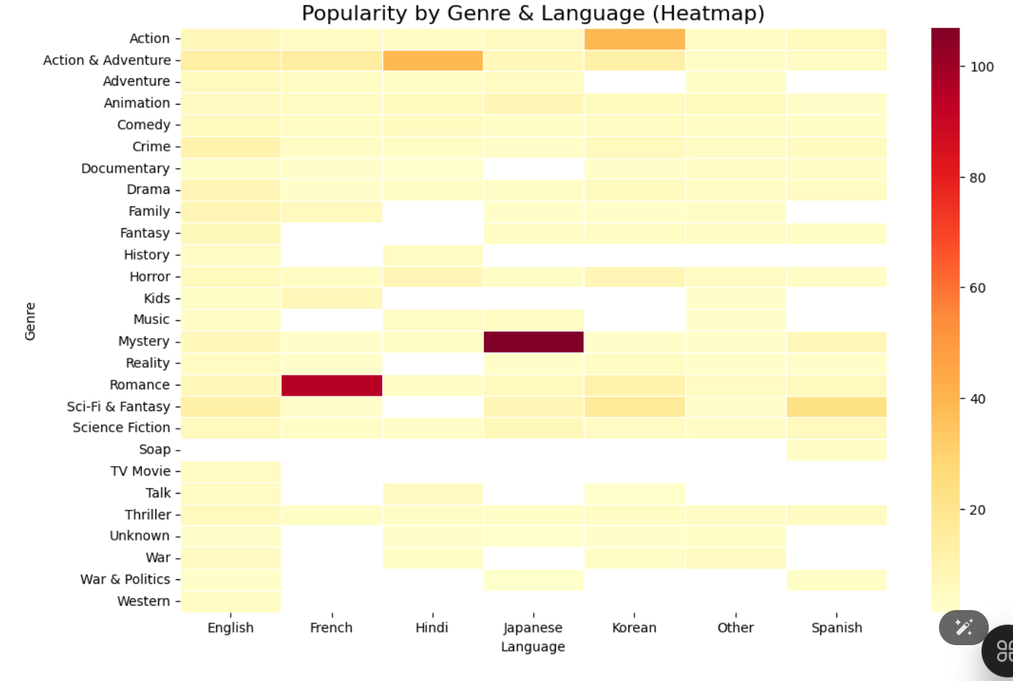
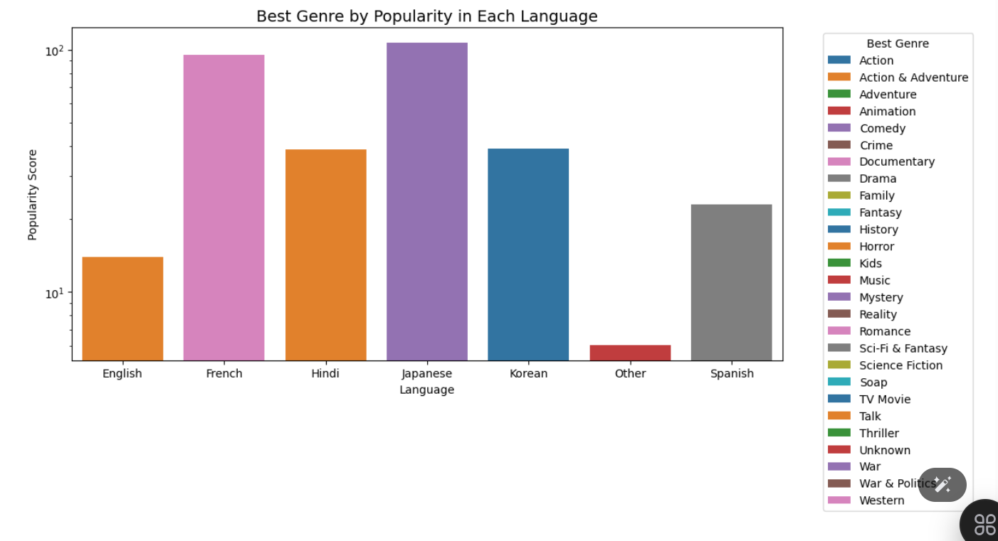

Slide 32
Key Insights — Netflix Content Analysis
Drama Overload: 28% of catalog but only 7% hit rate — too much focus, low returns.
Format Issue: TV Shows outperform Movies across most genres.
Language Bias: 53% of content is English, limiting global reach.
Low Quality: 89% of titles score below 8.0, showing weak quality control.
Low Hit Rate: Only 5.7% of titles are hits — major inefficiency.
Ignored Winners: Crime, Documentary, Thriller have higher hit rates but low focus.
Engagement Matters: Votes and engagement predict success better than ratings.
New ≠ Better: Older titles often rate higher than new releases.
Data Gaps: Many titles lack reliable rating data, hurting decisions.

Slide 33

Data-Driven Success Model & Recommendations
Key Drivers of Success:
High engagement score (>0.49 correlation with hits)
TV Shows outperform Movies (71% more likely to succeed)
Language-genre fit can create a 10x difference in performance
Only content with rating >7.5 and >1000 votes consistently succeeds
4-Pillar Strategy for Netflix:
Format Rebalancing: Shift to a 60/40 TV/Movie split
Genre Optimization: Reduce Drama by 200+ titles, expand in high-hit genres
Quality Gate: Implement a minimum rating threshold (6.5+)
Market Targeting: Invest in top language-genre segments (e.g., Korean, Japanese, Animation)

Slide 34

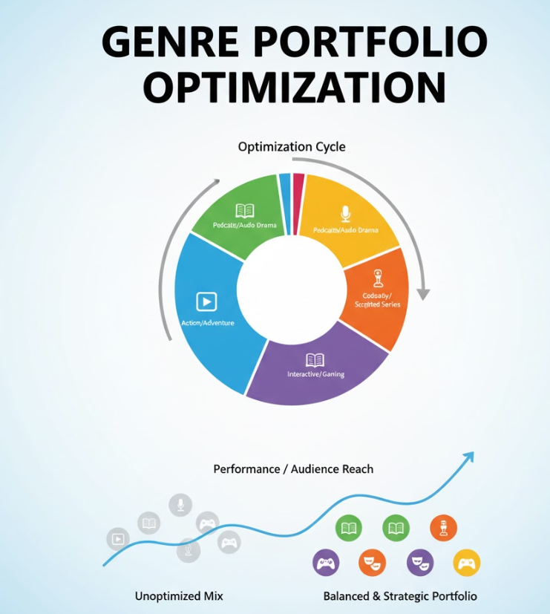
PILLAR 1 - Format Rebalancing
PILLAR 2 - Genre Portfolio Optimization
Current State: 50% TV Shows, 50% Movies
Target State: 60% TV Shows, 40% Movies
Action Step:
Redirect 200 Movie acquisitions to TV format
Leverage TV's 12/14 genre superiority
Expected Impact: 25% performance improvement
Drama Reduction:
Current: 1,110 titles → Target: 900 titles (reduce by 200)
Reason: To prevent viewers from feeling overwhelmed and keep their interest high.
Expand High-Engagement Genres:
Add 100 Thriller titles
Add 100 Horror titles (currently underserved)
Develop Sci-Fi TV Shows (missing opportunity)
Expected Impact: Genre hit rate from 7% to 12%

Slide 35
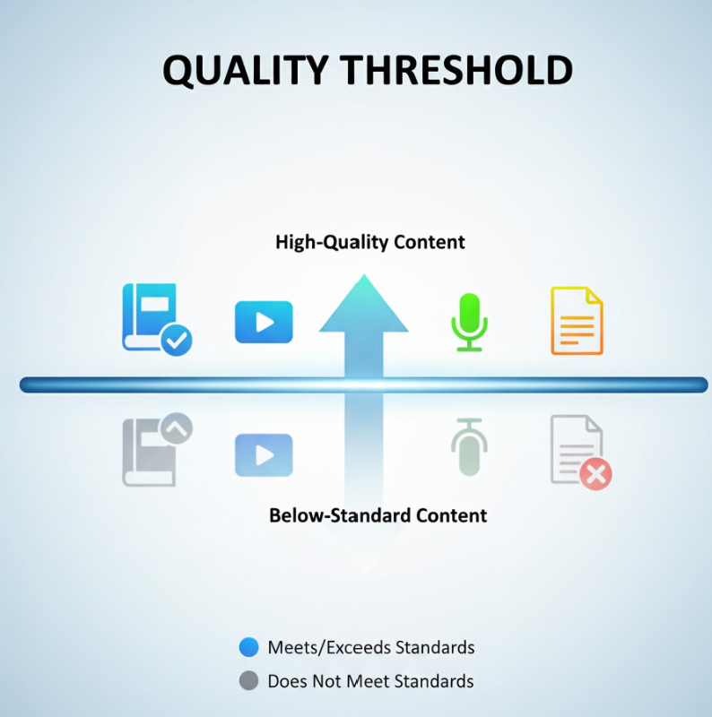
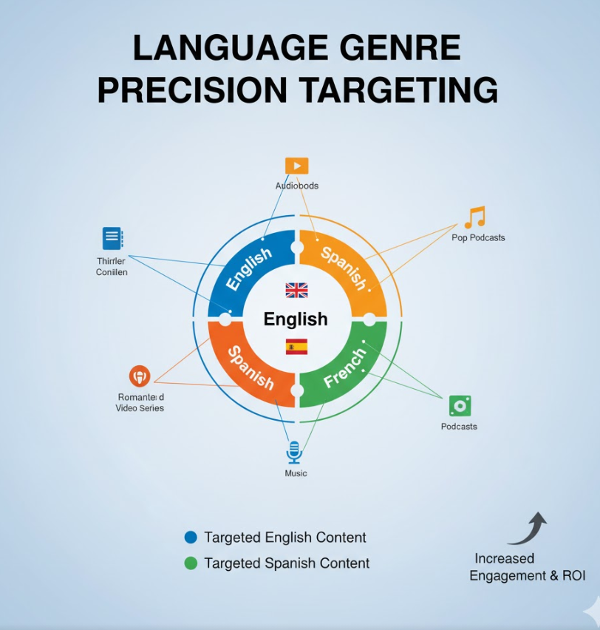
PILLAR 3 - Quality Threshold
PILLAR 4 - Language-Genre Precision Targeting
Implementation:
Establish 6.5 rating minimum for all new acquisitions
Eliminate bottom 35% quality tier (Average/Poor)
Create premium tier for 7.5+ rated content
Phase out all sub-6.0 content within 12 months
Expected Impact:
Average quality: 6.8 → 7.2 rating
Cost savings: $300-500M from eliminating poor content
Spanish Content: Increase 7% → 12% (Focus: Drama/Comedy, Avoid: Reality TV)
Mandarin Content: Increase 3.3% → 8% (Priority: Documentary/Animation)
Hindi Animation: Leverage 8.30 peak rating
Korean Content: Maintain 9% → 12% (Proven 7.0 consistency)
Reduce English Dependency: 53% → 45%
Expected Impact: 30% international content improvement

Slide 36

Projected Business Impact
Better Hit Rate: By focusing on top-performing formats, genres, and languages, the hit rate could increase from 7% to 15%.
Improved Quality: Average content ratings are expected to rise from 6.8 to over 7.2 by only acquiring titles that meet a minimum quality threshold of 6.5.
International Growth: Non-English hits could grow by 30% through targeted language and genre strategies.
Cost Savings: Removing low-performing, low-engagement titles could save $300–500 million annually.
More Efficient Catalog: A balanced, data-driven catalog will reduce oversaturation and boost audience retention.
Maximized ROI: Investing smarter means getting more hits with fewer titles, ensuring better returns on content spending.

Slide 37

Why This Solution Works :
Data-Driven: Based on analysis of 3,990 real titles, not assumptions
Actionable: Clear, measurable recommendations with timelines
Resource Optimized: Reallocates budget from Drama to TV format
Quality Focused: 6.5 rating floor prevents poor investments
Globally Strategic: Taps underutilized markets (Mandarin, Hindi)
Risk Reduction: TV format wins in 86% of genres

Slide 38
Challenges Faced :
Data Reliability: Nearly half of all titles had fewer than 100 votes, making ratings unreliable.
Solution: Created an engagement score by weighting ratings with vote count and validated it against real viewer behavior.
Genre Ambiguity: Many titles belong to multiple genres, complicating classification.
Solution: Used the first-listed genre as the ‘primary’ genre for consistent analysis.
Temporal Bias: Older titles get more votes over time, making comparisons unfair.
Solution: Grouped titles by release year and studied patterns across different years.
Outcome: These steps ensured insights reflect true drivers of success, not quirks in the data.

Slide 39


